Slide 1

Coffee Sales Analysis
Exploring Purchasing Patterns, Sales Trends, and Customer Preferences
- Aashirwad Mehare

Slide 2
Overview
Dataset Summary: The dataset contains detailed records of coffee sales from a vending machine.
Data Collection Period: From March 2024 to the present, capturing daily transactions.
Purpose: To analyze purchasing patterns, sales trends, and customer preferences related to different coffee types.

Slide 3
Project Objectives
Understanding customer purchasing behavior through different metrics.
Sales trend analysis over time to uncover patterns.
Customer preferences by coffee type and payment method.
Developing visual insights using Power BI for forecasting future sales and identifying key opportunities.

Slide 4
Data Understanding
Columns: date, datetime, cash_type, card, money, coffee_name.​
Coffee Varieties: Latte, Americano, Cappuccino, Hot Chocolate, Cocoa, Cortado, Espresso.
Payment Methods: Cash and Card.
Total Records: 1133 sales records.

Slide 5
Data Transformation (ETL)
Tools Used: Python (pandas, numpy).
Steps Involved:
Data Cleaning: Handled null values, date formatting.
Feature Engineering: Extracted day names, hours from datetime​.
Aggregation: Grouped data by coffee type, payment method, and time to derive insights​.

Slide 6
Exploratory Data Analysis (EDA)
Key Metrics Explored:
Overall Sales: Latte, Americano with Milk, and Cappuccino are the top-selling coffee types, contributing to 66.4% of total sales​.
Payment Preferences: Card payments significantly outweigh cash, highlighting a shift toward cashless transactions​.
Seasonality & Trends: Month 5 (May) showed a significant sales spike likely due to seasonal demand​.

Slide 7
Power BI Dashboard
Dashboard Highlights:
Coffee Type Preferences: Visualized through pie charts showing the distribution of revenue and sales.
Next Day, Week, and Month Sales Forecasting: Predictive analytics for future trends using time series​.
Sales Across Days and Hours: Identified peak hours (10 AM and 11 AM) and slower periods to optimize business operations​

Slide 8
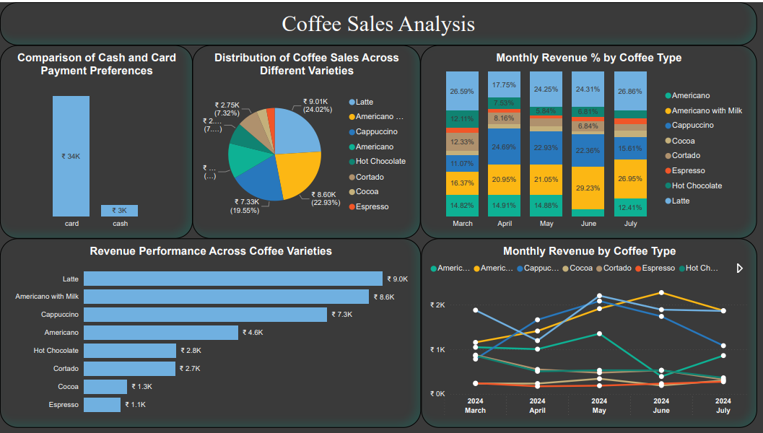
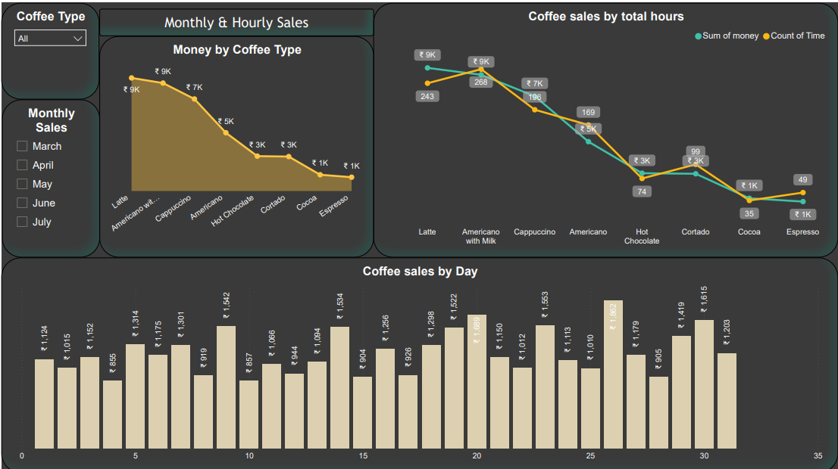
Power BI Dashboard

Slide 9
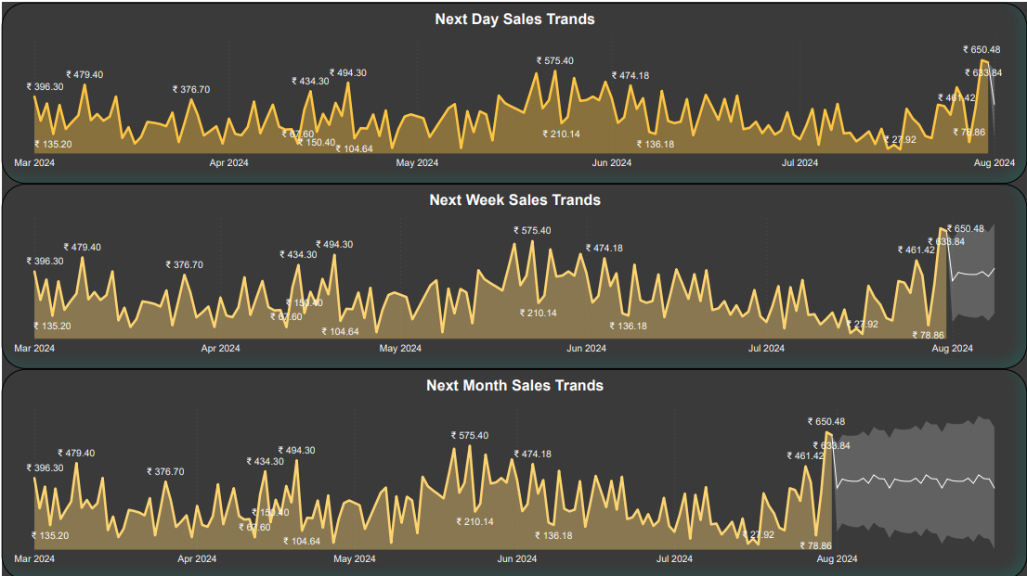
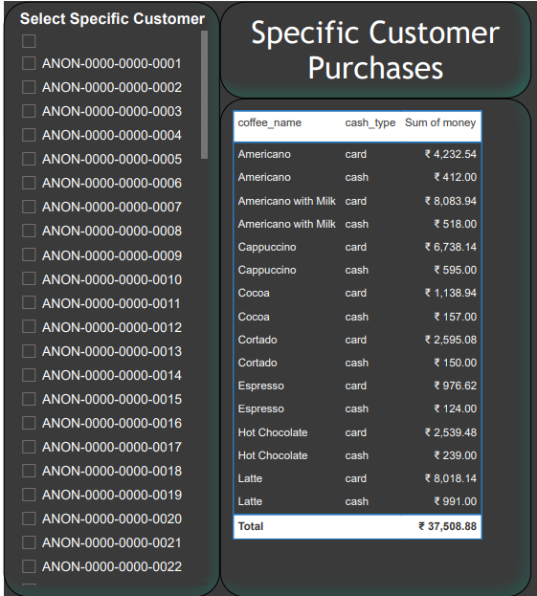
Power BI Dashboard

Slide 10
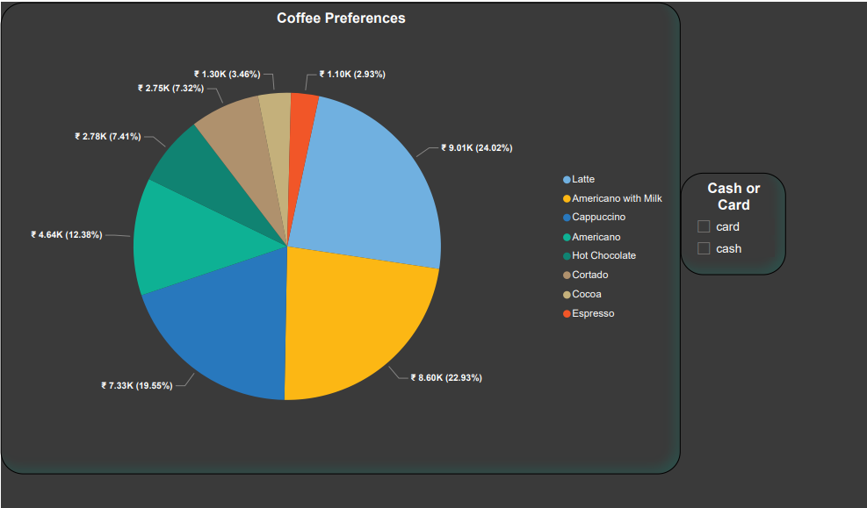
Power BI Dashboard

Slide 11
Key Insights & Recommendations
Insights:
Top Coffee Choices: Latte and Americano with Milk dominate sales​.
Payment Trends: Businesses can benefit by enhancing card payment facilities​.
Customer Loyalty: 37% of customers are returning buyers, mostly favoring Americano and Latte​.

Slide 12
Key Insights & Recommendations
Recommendations:
Promote lesser-selling coffees like Cortado and Cocoa to balance the menu​.
Optimize Staff During Peak Hours: Target 10 AM - 12 PM for more staff deployment​.
Discount Campaigns: During slow periods (afternoons) to boost sales​.

Slide 13
Future Actions
Implement Marketing Campaigns: Promote underperforming coffee types through loyalty rewards or promotions.
Data-Driven Forecasting: Use Power BI sales trend forecasting to stock inventory and adjust staffing​

Slide 14
Conclusion
Project Achievements:
Data Understanding, EDA, and Visualization were performed using Python and Power BI.
Actionable Insights derived from the data support business decision-making in pricing, customer targeting, and stock management.

Slide 15
Thank You!
LinkedIn :- linkedin/aashirwad-mehare
GitHub :- github/Aashirwad0123

